Slide 1


Samsung Supply chain dashboard
Presented By
Student Name: LAD PARTH VINODKUMAR
College Name: PARUL UNIVERSITY
Department: cse
Email ID: 2203051050403@Paruluniversity.ac.in

Slide 2
OUTLINE:
Problem Statement
Proposed System/Solution
System Development Approach
Algorithm & Deployment
Result (Output Image)
Conclusion
Future Scope
References

Slide 3
Problem Statement:
Organizations with complex supply chains often struggle to monitor supplier performance, shipment status, inventory levels, and customer demand in a single system.
Data related to suppliers, manufacturers, shipments, and customers is usually scattered across different sources, making it difficult to analyze operational performance and identify inefficiencies. Without a centralized analytical view, decision-makers cannot quickly evaluate revenue, profit, order fulfillment efficiency, or shipment distribution across product categories.
Therefore, there is a need for a system that can consolidate supply chain data and present meaningful insights for better operational monitoring.

Slide 4
Proposed Solution:
The proposed system is an interactive Supply Chain & Logistics Dashboard developed using Microsoft Power BI.
The dashboard integrates data from different supply chain entities such as suppliers, manufacturers, shipments, and customers to provide a centralized view of operational performance.
It visualizes key business metrics including total revenue, profit, profit margin, order quantity, inventory value, shipment quantity, and customer demand.
The dashboard allows stakeholders to quickly analyze supplier performance, product inventory distribution, and shipment trends through interactive charts and KPIs, enabling better decision-making.

Slide 5
System Approach:
The dashboard was developed using the following technologies:
Microsoft Power BI Desktop – for data visualization and dashboard creation
Power Query – for data cleaning and transformation
DAX (Data Analysis Expressions) – for creating calculated measures such as profit margin and aggregated metrics
Data Modeling – to establish relationships between supplier, manufacturer, shipment, and customer datasets
Interactive Visualizations – including KPI cards, bar charts, and donut charts for performance analysis
This approach ensures efficient data processing and clear representation of supply chain insights.

Slide 6
Algorithm & Deployment:
The dashboard development followed these steps:
Data Collection: Supply chain datasets containing supplier details, shipment data, inventory information, and customer orders were collected.
Data Cleaning & Transformation: Data was processed using Power Query to remove duplicates, handle missing values, and standardize formats.
Data Modeling: Relationships were created between multiple tables to enable cross-analysis of supply chain components.
Measure Creation: Key metrics such as Total Revenue, Profit, Profit Margin, Order Quantity, and Inventory Value were calculated using DAX formulas.
Dashboard Design: Various visualizations including KPI cards, bar charts, and donut charts were added to display performance insights.
Deployment: The dashboard can be deployed through Power BI Service for real-time monitoring and sharing with stakeholders.

Slide 7
Result:
The developed dashboard successfully visualizes the performance of the supply chain system. Key results include:
Total Revenue: 176.95M
Total Profit: 48.56M
Profit Margin: 27%
Perfect Order Rate: 75%
Total Shipments: 7500
The dashboard also provides insights into supplier order quantities, product inventory distribution, and shipment categories such as smartphones, tablets, televisions, wearables, and appliances.

Slide 8
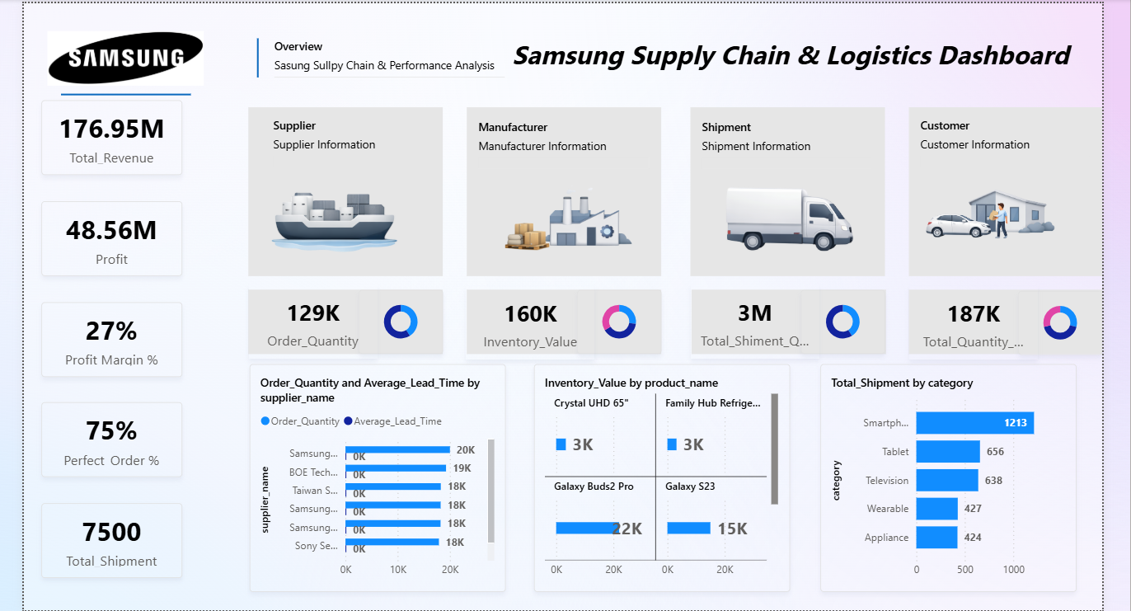
dashboard:

Slide 9
Conclusion:
The Supply Chain & Logistics Dashboard provides a comprehensive analytical view of business operations by integrating supplier, manufacturer, shipment, and customer data into a single platform. Through interactive visualizations and key performance indicators, the system enables organizations to monitor revenue, profit, order fulfillment performance, and product demand effectively. This dashboard improves transparency in supply chain operations and helps decision-makers identify trends, optimize logistics, and enhance overall operational efficiency.

Slide 10
Future scope:
The system can be further enhanced by:
Integrating real-time data sources for live supply chain monitoring
Adding predictive analytics to forecast product demand and shipment delays
Implementing AI-based supply chain optimization
Incorporating geographical maps for shipment tracking
Deploying the dashboard on Power BI Service for global access and collaboration

Slide 11
References:
Microsoft Power BI Official Documentation – https://learn.microsoft.com/power-bi
Microsoft Elevate AICTE Internship Learning Resources
Supply Chain Analytics Concepts and Visualization Techniques
Power BI Data Modeling and DAX Functions Documentation
GitHub Link: Link

Slide 12
Thank You

